Slide 1
KNN, Decision Trees & Random Forests

Slide 2
Agenda
Start | End | Item
6:30 | 6:45 | K Nearest Neighbor - explanation
6:45 | 7:00 | East Side Vs West Side!
7:00 | 7:15 | Absenteeism KNN example
7:15 | 7:30 | Break
7:30 | 7:45 | Decision Trees - explanation
7:50 | 8:00 | Decision Tree Example
8:00 | 8:15 | A to Z Decision Trees scripting example
9:05 | 9:15 | Break
8:15 | 8:45 | Random Forests

Slide 3
Classification not Prediction
Quick Review
Does anyone remember logistic regression vs linear regression?
What are the differences?
Why doesn’t prediction (continuous) modeling help for classification problems?
What are examples of classification problems?

Slide 4
What is the difference between prediction & classification?
CLASSIFICATION- “bucketing” observations into distinct categories. Answers questions with distinct classes
Will a potential customer buy or not? Yes or No.
What will the outcome of surgery be? The patient can recover, remain ill or die.
PREDICTION – An observation’s attributes predict a numerical outcome and is therefore a continuous outcome. Answers amount or quantity questions.
How much will a customer spend? Could be $0 to $x
How long will the patient live after surgery? Could be 0 days to Y days or years.
The two ideas are related because both are part of data mining however the methodologies and evaluation measures differ.

Slide 5
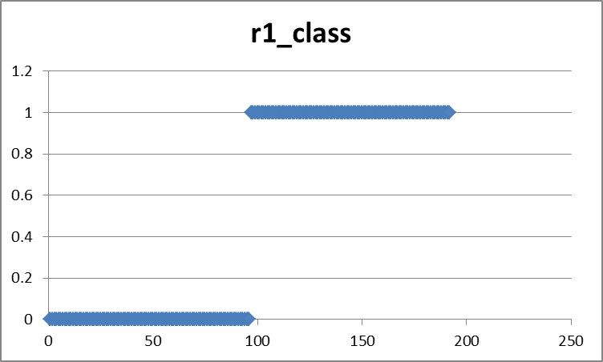
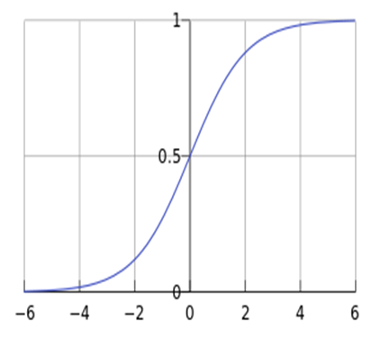
Classification – Logistic Regression (again)
Used for binary operators (yes or no, A or B)
Scatter of the class outcomes
will look something like this.
New scatter shows probability curve approaching 0 & 1
Probability is the y axis
Success Class Observations
Logit is the x axis
Failure Class Observations

Slide 6
Now a new Classification Approach - KNN
Characteristics of KNN
Data-driven, not heuristics (rules) based
No parameters, beta coefficients, means time to predict or classify can be lengthy because each new record is scored against the existing training set.
Makes no assumptions about the data e.g. outliers, non-normal distributions – all are accepted

Slide 7
Basic Idea
For a given record to be classified, identify nearby records
“Near” means records with similar predictor values X₁, X₂, … X_{p}
Classify the record as whatever the predominant class is among the nearby records (the “neighbors”)
Your brain makes similar associative leaps…the upcoming example proves it!

Slide 8
How to measure “nearby”?
The most popular distance measure is Euclidean distance
DON’T WORRY ABOUT THIS
R will handle it!
Typically, predictor variables are first normalized (= standardized) to put them on comparable scales
An easy and consistent method for normalization is to use preProcess() from caret but can also be done with scale()
Without normalization, metrics with large scales dominate

Slide 9
Choosing k
K is the number of nearby neighbors to be used to classify the new record
K=1 means use the single nearest record
K=5 means use the 5 nearest records all have a “vote”
Typically choose that value of k which has lowest error rate in validation data
Use odd numbers to avoid ties
Let’s predict the probability of “Class A”
K= | Possible Outcomes
1 | Nearest neighbor is class A so 100% therefore class B probability is 0%
2 | Nearest 2 neighbors agree class A so 100%, or all neighbors are class B so 0% or neighbors are split so outcome is 50%
3 | Nearest 3 neighbors agree class A so 100%, or all neighbors are class B so 0%, or they split 33% or 66%. With a cutoff of 50% you can still make a classification.
4 | Nearest 4 neighbors agree class A so 100%, all neighbors are class B so 0%, or they split 25%, 50% or 75%. Cases of 50% probability are troublesome to determine same as K = 2.

Slide 10
Low k vs. High k
Low values of k (1, 3, …) capture local structure in data (but also noise)
High values of k provide more smoothing, less noise, but may miss local structure
Note: the extreme case of k = n (i.e., the entire data set) is the same as the “naïve rule” (classify all records according to majority class)

Slide 11
Agenda
Start | End | Item
6:30 | 6:45 | K Nearest Neighbor - explanation
6:45 | 7:00 | East Side Vs West Side!
7:00 | 7:15 | Absenteeism KNN example
7:15 | 7:30 | Break
7:30 | 7:45 | Decision Trees - explanation
7:50 | 8:00 | Decision Tree Example
8:00 | 8:15 | A to Z Decision Trees scripting example
9:05 | 9:15 | Break
8:15 | 8:45 | Random Forests

Slide 12

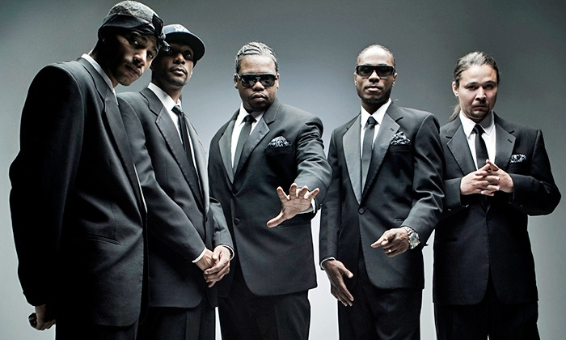
KNN Classification
Rep your HOOD!
From East 99th Street & St. Clair in Cleveland
Talk about it a lot…
Lets try to understand if a house is in East or West Cleveland and Bone Thugs would live there based on some attributes.

Slide 13
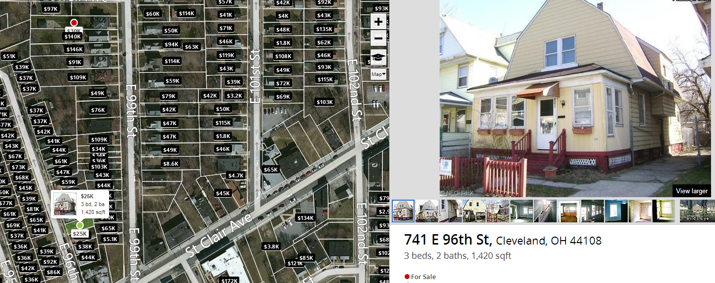
Bone Thugs Hood on Zillow

Slide 14
Attributes of houses here…
$25K
3 beds
2 baths
1,420 sqft
44108 zip

Slide 15
Collected a small data set comparing East Cleveland to West.
West Cleveland
East Cleveland
Beds | Bath | SqFt | Zip | Price
4 | 4.5 | 4110 | 44107 | 1.175M
5 | 1.75 | 1616 | 44107 | $155K
4 | 2 | 1480 | 44107 | $64K
4 | 4 | 2640 | 44107 | $279K
5 | 5 | 4175 | 44107 | $525K
5 | 2.5 | 1702 | 44107 | $120K
3 | 1 | 1582 | 44107 | $103K
3 | 2 | 1292 | 44107 | $100K
3 | 3 | 1780 | 44107 | $159K
Beds | Bath | SqFt | Zip | Price
3 | 1 | 1181 | 44108 | $65K
3 | 1.5 | 1391 | 44108 | $39K
4 | 1 | 1424 | 44108 | $39K
4 | 2 | 1895 | 44108 | $30K
5 | 1 | 1607 | 44108 | $50K
4 | 1 | 1312 | 44108 | $11K
3 | 1 | 1152 | 44108 | $5K
4 | 1 | 1556 | 44108 | $81K
2 | 1 | 811 | 44108 | $46K
What patterns do we observe in this data?

Slide 16
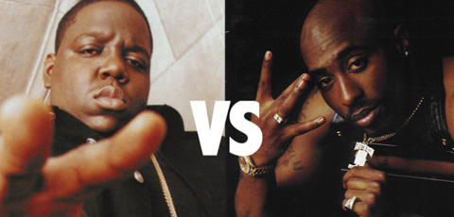
Here are some unknown houses…
East Side or West Side?
Beds | Bath | SqFt | Zip | Price
5 | 1.5 | 1136 | 44107 | $48K
6 | 3 | 4500 | 44107 | $259K
3 | 1.5 | 1300 | 44108 | $85K
3 | 2 | 1300 | 44108 | $106K
2 | 2 | 1170 | 44107 | $200K
5 | 2 | 2592 | 44108 | $95K
3 | 1 | 1398 | 44107 | $100K
3 | 2 | 1300 | 44108 | $106K
3 | 1.5 | 1614 | 44108 | $124K

Slide 17
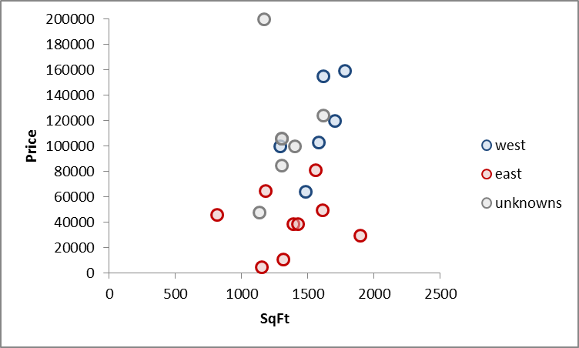
Let’s pick two house attributes, sqft and price
Plot East, West and Unknown houses on a scatter

Slide 18
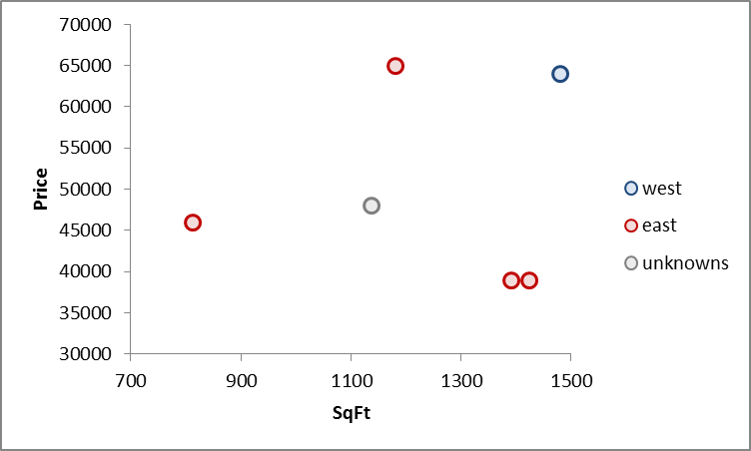
KNN Measures the Euclidean distance between points
Lets zoom in to a specific point
Without knowing distances or making calculations:
What side of the city do you think the unknown is?

Slide 19
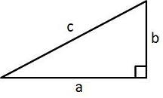
Euclidean Distance measures distance like a ruler
Remember Pythagorean Theorem?
In our example…
A²+B²=C²
b
c
a

Slide 20
Euclidean Distance measures distance like a ruler
In our example…
Define the segment values
EastSidePt = (1391sqft, $39K)
UnknownPt = (1136sqft,$48K)
aSegment = 1391-1136 = 255sqft
bSegment = $39k-$48k = $-9k
b
c
a

Slide 21
Euclidean Distance measures distance like a ruler
In our example…
Math time…
EastSidePt = (1391sqft, $39K)
UnknownPt = (1136sqft,$48K)
aSegment = 1391-1136 = 255sqft
bSegment = $39k-$48k = $-9k
c
A² + B² = C²
b
a
$-9000² + 255² = c ²
$81,000,000 + 65025 = c ²
$81,065,025= c ²
Sqrt($81,065,025)= c
9003 = c
The distance between the unknown and the closest East side point is 9003*.
We didn’t normalize (put all attributes on the same scale) so you can see that large impact price has on the distance moving from 9000 to 9003 but that’s not the point…this is just to show you a distance calc.

Slide 22
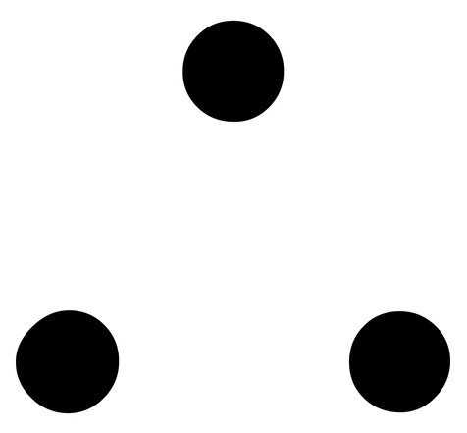
Euclidean Distance measures distance like a ruler
Remember Pythagorean Theorem?
In our example…
A²+B²=C²
c
b
a
West Side (1480sqft, $64K)
Unknown (1136sqft, $48K)
Distance
or C = 16003
Differences (45sqft, $17K)
b
a

Slide 23
Your guess
16003
9003
With K = 1, the single nearest neighbor, what is the class? What about k=2? K=3?

Slide 24
K = 1
This unknown case is in…
In our example…
East Cleveland
5 Beds
1.5 Bath
1136 sqft
44107 Zip
$48K
16003
9003
The KNN algorithm would have correctly identified East Cleveland if K = 1. Remember the algorithm performs this along more than 2 dimensions, in hyperspace.

Slide 25
K is a tuning parameter the practitioner chooses.
You will have to specify how many neighbors are to be looked at.
In our example…
Measured in hyperspace (many attributes not just 2)
Ties are randomly chosen for even number K but can be avoided using odd number K.
Returned results can be either the class (east or west) or the probability of a particular class.
17000
16003
9003
*scale is misleading because of attributes order of magnitude
Remember to normalize!
K=1 of only these 2 variables would say it is East Cleveland with a 100% certainty.
K=3 of only these 2 variables would say it is East Cleveland with a 66% probability.
Review confusion table to get to an acceptable K.

Slide 26



Special K!
K=1
?
K | Big House | Lil House | Guess | Actual | Notes
1 | 1 | 0 | Big House |  | Local Structure
5 | 1 | 4 | Lil House |  | Just right
10 | 6 | 4 | Big House |  | Majority Structure
K=5
K=10
Perhaps more so than other methods, tuning your KNN is of the utmost importance.

Slide 27
Open Normalization Example Script
This script will show you how R “scales” and “centers” data to be on the same magnitude.

Slide 28
Agenda
Start | End | Item
6:30 | 6:45 | K Nearest Neighbor - explanation
6:45 | 7:00 | East Side Vs West Side!
7:00 | 7:15 | Absenteeism KNN example
7:15 | 7:30 | Break
7:30 | 7:45 | Decision Trees - explanation
7:50 | 8:00 | Decision Tree Example
8:00 | 8:15 | A to Z Decision Trees scripting example
9:05 | 9:15 | Break
8:15 | 8:45 | Random Forests

Slide 29

Classifying Absenteeism at Work
Business Context:
Workers that are absent are costly to businesses.
In the US absenteeism is estimated to be $225.8B or $1685 per employee EACH YEAR*
Understanding absenteeism reasons could lead employers to offer new benefits (like in office medical services) to reduce absenteeism
Dataset Source and Info:
http://archive.ics.uci.edu/ml/datasets/Absenteeism+at+work
The database was created with records of absenteeism at work from July 2007 to July 2010 at a courier company in Brazil.
740 Rows * 21 Attributes
Rather than calculate the probability of an employee being absent or not in the future, our business objective is to classify the reason the employee is missing so we can possibly tailor employee support.
“What is the probability the absent employee is out because of “dental consultation” or “medical consolation”?
https://www.cdcfoundation.org/pr/2015/worker-illness-and-injury-costs-us-employers-225-billion-annually

Slide 30
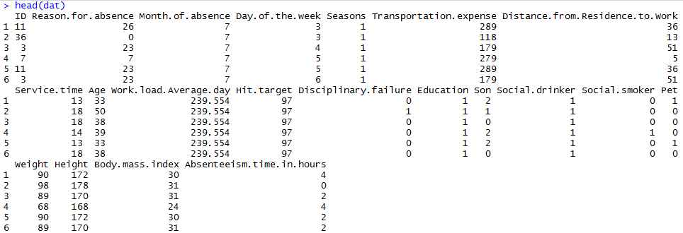
Absenteeism Data
dat$Reason.for.absence is not really a numeric vector but stands for a class of illness explanation.

Slide 31

Open knn example classification.R
We will build a KNN model classifying the reasons employees have been absent. A model like this can help classify new absent employees so we can learn what to offer to mitigate absenteeism costs.

Slide 32
Using K-NN for Prediction (Continuous)
Instead of “majority vote determines class” use average of response values
May be a weighted average, weight decreasing with distance
KNN has drawbacks but can be used for both prediction and classification so it demonstrates flexibility in that regard.

Slide 33
Advantages – still true with prediction
Simple
No assumptions required about Normal distribution
Effective at capturing complex interactions among variables without having to define a statistical model

Slide 34
Shortcomings
Required size of training set increases exponentially with # of predictors, p
This is because expected distance to nearest neighbor increases with p (with large vector of predictors, all records end up “far away” from each other)
In a large training set, it takes a long time to find distances to all the neighbors and then identify the nearest one(s)
These constitute “curse of dimensionality”

Slide 35
Dealing with the Curse
Reduce dimension of predictors (e.g., with PCA) – not covered here
Computational shortcuts that settle for “almost nearest neighbors” – also not covered

Slide 36
KNN Summary
Simple concept, useful for classification & prediction
Classification – majority class of nearest neighbors wins
Prediction – average value among nearest neighbors
Find distance between known and unknown records
“Curse of dimensionality” – need to limit # of predictors
Slow to predict new records – non-parametric

Slide 37

Open knn example prediction.R
Now let’s predict how much time an absent employee will miss based on their attributes. The predicted outcome is now Absenteeism.time.in.hours which ranges from 0 to 120hrs.

Slide 38
Agenda
Start | End | Item
6:30 | 6:45 | K Nearest Neighbor - explanation
6:45 | 7:00 | East Side Vs West Side!
7:00 | 7:15 | Absenteeism KNN example
7:15 | 7:30 | Break
7:30 | 7:45 | Decision Trees - explanation
7:50 | 8:00 | Decision Tree Example
8:00 | 8:15 | A to Z Decision Trees scripting example
9:05 | 9:15 | Break
8:15 | 8:45 | Random Forests

Slide 39
Decision Trees
By observing the data and splitting it into sections, rules are created for either prediction or classification problems.
Mimics a subject matter expert…pre data mining days.
Before data mining, an experienced marketing bank manager may have said “let’s call our married customers over 25 that have at least a college education to see if they want another loan.”

Slide 40
Key Ideas
Recursive partitioning: Repeatedly split the records into two sections so as to achieve maximum homogeneity of outcome within each new section
Pruning the tree: Simplify the tree by pruning peripheral branches to avoid overfitting – measure and reduce complexity

Slide 41
Advantages of Decision Trees
Understandable, rules are human readable; executives love looking at them
Light weight, fast
Easy to implement…logic can be built in Excel even
Variable selection is automatic
No assumptions of data
Works with minimal data preprocessing

Slide 42
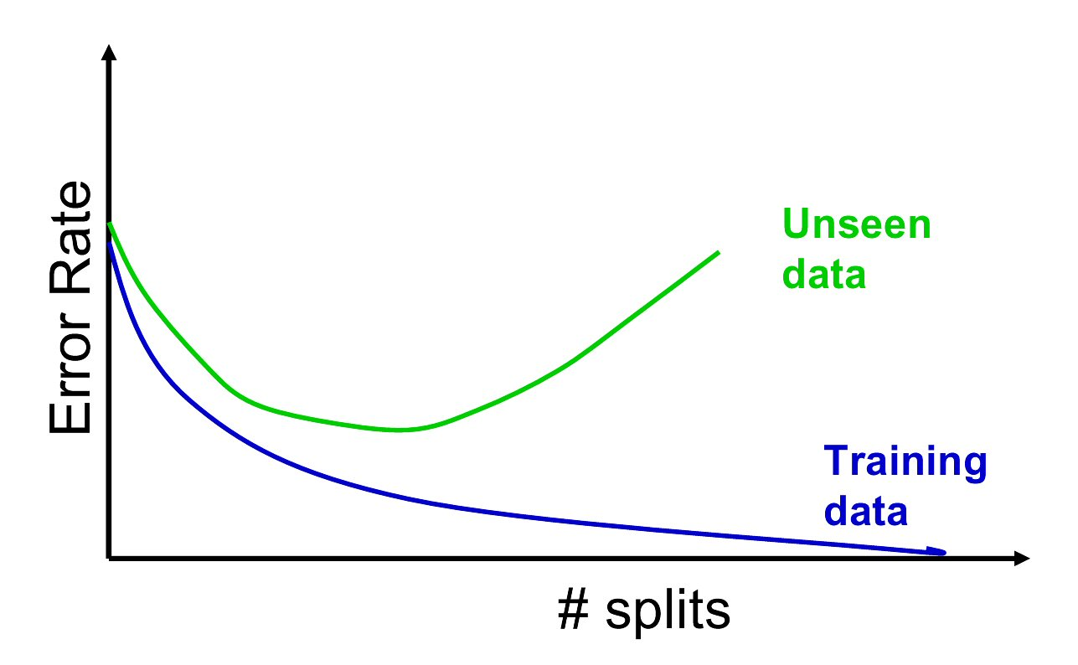
Disadvantages of Decision Trees
Overfitting!! You could create rules down to individual records so you get perfect accuracy (100% purity in each section). This wouldn’t generalize to new unseen data.
This is why having a training, test and holdout partition is important when making a decision tree. In production it is also important to review results of a model periodically to ensure the historical patterns aren’t evolving.

Slide 43
Recursive Partitioning Steps
Pick one of the predictor variables, x_{i}
Pick a value of x_{i,} say s_{i}, that divides the training data into two (not necessarily equal) portions
Measure how “pure” or homogeneous each of the resulting portions is
“Pure” = containing records of mostly one class (or, for prediction, records with similar outcome values)
Algorithm tries different values of x_{i,} and s_{i} to maximize purity in initial split
After you get a “maximum purity” split, repeat the process for a second split (on any variable), and so on

Slide 44
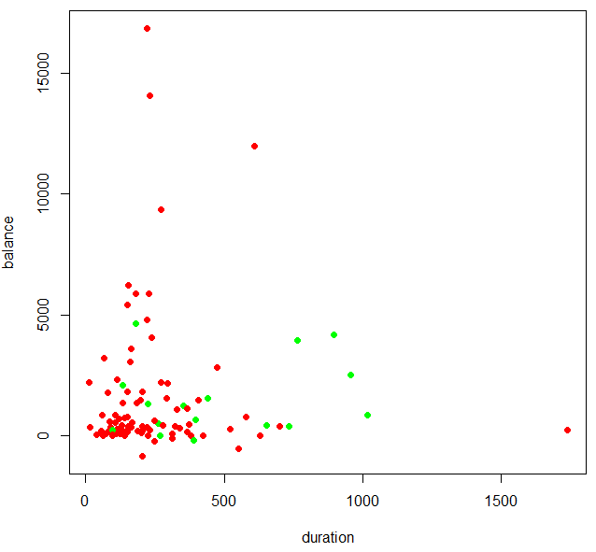
Suppose this is our data
Let’s classify offer acceptance among real bank customers using a decision tree. Green means they accepted the offer to open a new deposit account.
https://archive.ics.uci.edu/ml/datasets/bank+marketing

Slide 45
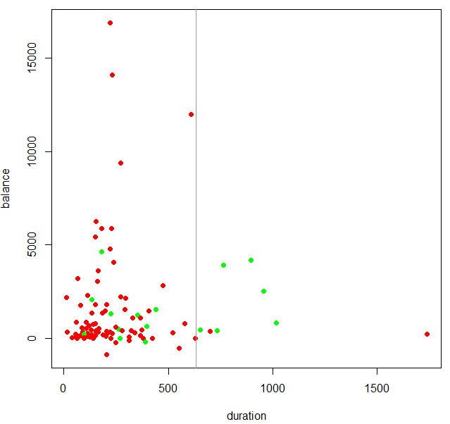
Suppose this is our data
Purity = 6 accepted among 8 offers
There are a lot of accepted offers with account holders of duration >635 days

Slide 46
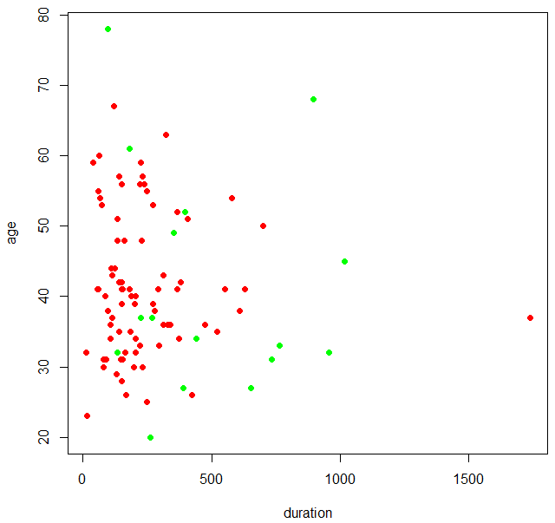
Now another view of the data
Here we see another dimension, age of the account holder along with duration.

Slide 47

With the rule duration > 635
The first rule still holds true but now we can think about adding new rule layers.

Slide 48

New Rule
A
B
Purity of split “A”= 6 accepted among 8 offers
Purity of split “B” = 1 of 1
In this toy example, we can add another rule stating age > 68 to capture another positive response and create another rule.

Slide 49
Code for last plots
dat<-read.csv('bank.csv', sep=';')
outcome <- ifelse(dat$y=='no',0,1)[1:100]
xVal <- dat$duration[1:100]
yVal <- dat$balance[1:100]
outcomeCols <- cut(outcome, 2, labels = c("red", "green"))
plot(xVal,yVal, col = as.character(outcomeCols),
xlab = 'duration',
ylab = 'balance',
pch = 16)
abline(v = 635, col = "gray60")
##
outcome <- ifelse(dat$y=='no',0,1)[1:100]
xVal <- dat$duration[1:100]
yVal <- dat$age[1:100]
outcomeCols <- cut(outcome, 2, labels = c("red", "green"))
plot(xVal,yVal, col = as.character(outcomeCols),
xlab = 'duration',
ylab = 'age',
pch = 16)
abline(v = 635, col = 'gray60')
segments(635, 68, 0, 68, col='blue')

Slide 50
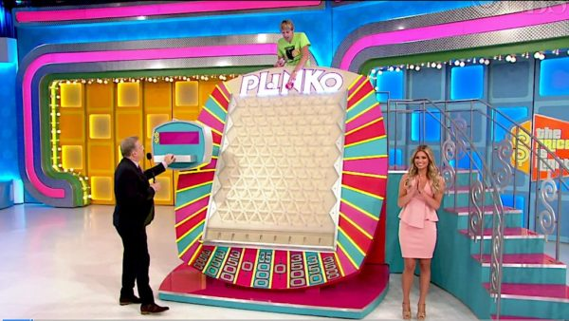
Our rule set is like Plinko!
With our rule tree we can score a new potential customer to call.

Slide 51
2 Rule Tree
Age > 68
No
Yes
Duration > 635
No
Yes
No (9 of 91)
Yes (6 of 8)
Yes
(1 of 1)

Slide 52
2 Rule Tree
Age > 68
Decision Node
No
Yes
Duration > 635
No
Yes
No (9 of 91)
Yes (6 of 8)
Yes
(1 of 1)
Terminal Node or “Leaf” Node

Slide 53
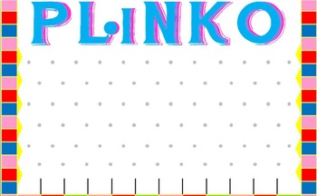
Let’s drop a new record down our plinko tree
Age > 68
No
Yes
Duration > 635
No
Yes
No (9 of 91)
Yes (6 of 8)
Yes
(1 of 1)

Slide 54
Let’s drop a new record down our plinko tree
Age = 39
Duration = 640
Age > 68
No
Yes
Duration > 635
No
Yes
No (9 of 91)
Yes (6 of 8)
Yes
(1 of 1)

Slide 55
Let’s drop a new record down our plinko tree
The age was less than 68 so the record drops to the next decision point.
Age > 68
Age = 39
Duration = 640
No
Yes
Duration > 635
No
Yes
No (9 of 91)
Yes (6 of 8)
Yes
(1 of 1)

Slide 56
Let’s drop a new record down our plinko tree
The duration is greater than 635 so the record lands at YES with a probability of 75% (6/8).
Age > 68
No
Yes
Duration > 635
No
Yes
Age = 39
Duration = 640
No (9 of 91)
Yes (6 of 8)
Yes
(1 of 1)

Slide 57
2 Rule Tree
Age = 39
Duration = 640

Slide 58
Let’s drop another record down our plinko tree
Age = 25
Duration = 365
Age > 68
No
Yes
Duration > 635
No
Yes
No (9 of 91)
Yes (6 of 8)
Yes
(1 of 1)

Slide 59
Let’s drop a new record down our plinko tree
The age was less than 68 so the record drops to the next decision point.
Age > 68
Age = 25
Duration = 365
No
Yes
Duration > 635
No
Yes
No (9 of 91)
Yes (6 of 8)
Yes
(1 of 1)

Slide 60
Let’s drop a new record down our plinko tree
Now the duration is less than 635 so the record drops to the terminal “NO” and has a probability of accepting the loan offer of ~10%
Age > 68
No
Yes
Duration > 635
No
Yes
Age = 25
Duration = 365
No (9 of 91)
Yes (6 of 8)
Yes
(1 of 1)

Slide 61
2 Rule Tree
Keep in mind a different algorithm may have come to a different conclusion…what about KNN? Also, adding more rules may find the local structure closer to this point so some judgment must still be made when constructing a tree.
Age = 25
Duration = 365

Slide 62
How a decision tree really splits data.
Order records according to one variable, say duration
Take a predictor value, say 600 (from the first record) and divide records into those with duration >= 600 and those < 600
Measure resulting purity (homogeneity) of class in each resulting portion
Try all other split values within the duration vector
Repeat for other variable(s)
Select the one variable & split that yields the most purity
Since it splits at various values within a single vector, there is no need to standardize (center, scale, normalize).

Slide 63
For categorical X variables keep in mind
The algo will examine all possible ways in which the categories can be split.
E.g., categories A, B, C can be split 3 ways
{A} and {B, C}
{B} and {A, C}
{C} and {A, B}
With many categories, # of splits grows and can be time consuming to fit the model

Slide 64
An example of overfitting…
2 rules still have some impurity in each section. Maybe we should keep adding rules.

Slide 65
An example of overfitting…
Adding this rule improves the purity
Age < 22

Slide 66
An example of overfitting…
These additional rules look like they help too.
Age > 62
Duration > 1100
Age < 22

Slide 67
An example of overfitting…
Great these rules are 100% pure! Our decision tree is perfect.
WRONG! Some of the rules were made for a single marketing offer. We fit to closely to the local structure so when we need to make a decision in the future this model wont be as accurate!
Age >38
Age <39
Duration >225
Duration < 300
Perfect node, but this is a rather specific customer case.

Slide 68
cp- complexity parameter
The cp value measures the size of the tree compared to its ability to separate the data. The tree will grow until the next split doesn’t reduce the cp value…meaning that split added more complexity than is gained from the purity of the node.
Setting cp to a negative amount ensures that the tree will be fully grown.

Slide 69
Open Bank Loans Decision Tree.R

Slide 70
Agenda
Start | End | Item
6:30 | 6:45 | K Nearest Neighbor - explanation
6:45 | 7:00 | East Side Vs West Side!
7:00 | 7:15 | Absenteeism KNN example
7:15 | 7:30 | Break
7:30 | 7:45 | Decision Trees - explanation
7:50 | 8:00 | Decision Tree Example
8:00 | 8:15 | A to Z Decision Trees scripting example
9:05 | 9:15 | Break
8:15 | 8:45 | Random Forests

Slide 71
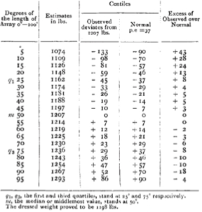
Random Forests…the Wisdom of the Crowd
1907 Vox Populi by Sir Francis Galton created the notion of “wisdom of crowds” as a phenomenon. It is the basis of modern search engines and crowdsourcing.
Prevailing wisdom at the time was that crowds acted irrationally
Riots, mobs, cults
Galton wanted to explore trustworthiness and peculiarities of popular judgment
Galton attended an Ox weight guessing competition at a cattle exhibition
Participants individually guessed a very wide weight range
The median weight was 9lbs (0.8%) off and was better than individual cattle experts.

Slide 72
Conditions for Wisdom of Crowds
Some machine learning methods behave like the cattle weight guessing participants.
For people:
Each individual member or voter must have an independent source of information (examine the cattle for themselves)
Make an individual guess not swayed by others (avoid group think or be blind to others’ guesses
Mechanism must be in place to collate and organize the diverse votes.
For algorithms:
Each individual method needs to be blind to the others in construction
Each individual classification or vote is therefore independent
Aggregation/tabulation is easy in an computerized environment.
Many of today’s best algorithms mimic a weak learner approach.

Slide 73
Random Forests
Each mini tree acts as a voter from the mob. Each voter is allowed to look at a random group of variables e.g. a mini data set to make its splits.
This toy example shows 2 variables were selected for each voter from among beds, baths, sqft and price. An individual tree may choose beds/baths while another may get beds/sqft and still another gets sqft/price.
A random forest grows many many classification trees
Variable combinations are selected randomly to create the forests but the number of variables or attributes needs to be specified
Each unknown value is then put through each tree to provide a final classification
Each tree then casts a vote for the unknown value.
Each “dumb” learner gets a vote that is tabulated so the wisdom of the mob can be identified.
East
West
East
West
East
East
Vote Tally
East | West
4 | 2
Since each tree focuses on a random combination of variables and random rows (boostrap), some trees will be more accurate, others less so. In total the splits will identify most informative variables, the ones that are usually split upon and with enough trees the group wisdom is found.

Slide 74
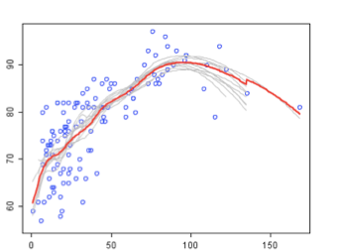
Random Forests
Fictitious Visual
Data Science Considerations
Group
Consensus
How many trees/voters?
How many decision points (nodes)?
How many features are allowed to be used in each random subset (last example showed 2)?
How to account for missing values?
Class A
Weak
Learners
Class B
In this example, each decision tree tries to separate the data and by taking the most numerous outcome (tally) the best outcome is often found. Since they are weak learners (not a lot of depth and with fewer variables) among hundreds, overfitting is usually less of a concern.

Slide 75
How a random forest is really grown.
Draw many re-samples of cases from the data (boostrap)
For each re-sampled set use a random subset of predictor variables to produce a tree. Some parameters include
Number of trees to grow – dictates the number of re-sampled sets
Number of predictor variables for each tree
Combine the predictions/classifications from all the trees (the entire forest)
Votes are tallied for classification problems
Predictions are averaged for continuous problems
Since it has many weak learners, overfitting is less of a concern.
Since its fitting many hundreds of trees, it takes some time to train a model.

Slide 76
Open Bank Loans RandomForest.R

Slide 77
Summary
Classification and Regression Trees are an easily understandable and transparent method for predicting or classifying new records
A single tree is a graphical representation of a set of rules
Tree growth must be stopped to avoid overfitting of the training data – cross-validation (CV) helps you pick the right cp level to stop tree growth – will cover CV later if time
Ensembles (random forests, boosting) improve predictive performance, but you lose interpretability and the rules embodied in a single tree

